Slide 1

S.G.KAVIYA
Final Project

Slide 2
Table of contents
01
04
02
05
03
06
PROBLEM STATEMENT
SOLUTIONS
PROJECT OVERVIEW
MODELLING
END USERS
RESULT

Slide 3

PROBLEM STATEMENT
One of the most challenging image processing tasks is rendering a picture's semantic content in many styles.
We employ object recognition-optimized Convolutional Neural Network image representations, which explicitly provide high level visual information.
We present A Neural Algorithm of Artistic Style, which is capable of dissecting and reassembling the content and aesthetics of natural photographs.
Image collusion aims to generate a new image by integrating the artistic style of one image (style image) with the content of another image (content image).

Slide 4

PROJECT OVERVIEW
01
A unique deep learning technique called Image collusion lets us combine the artistic style of one image with the information of another.
Through the exploration of NST concepts and application in this project, we produced visually captivating photographs with a distinct artistic flair.
02

Slide 5

OBJECTIVES OF THE PROJECT

Slide 6
Gain an understanding of the fundamentals of brain style transmission, particularly the distinction between style and substance in images.
Make use of well-known deep learning frameworks such as TensorFlow or PyTorch to implement a neural style transfer model.
To discover the creative possibilities of NST, play around with various content and style image combinations.

Slide 7





END USERS
END USERS
Neural style transfer (Image collusion) has a broad range of end users, with applications catering to various creative and technical fields.
BUSINESS
DEVELOPERS
RESEARCHERS
ARTISTS AND DESIGNERS
CONTENT CREATORS

Slide 8
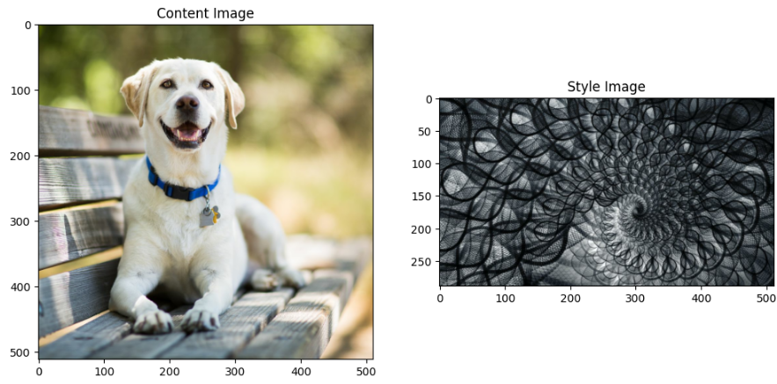
SOLUTION
The ability to imaginatively blend the content of one image with the artistic style of another is the primary answer provided by neural style transfer (Image collusion)
CONTENT PRESERVATION
STYLE TRANSFER
Image collusion seeks to preserve the scene, items, and general arrangement of a selected content image. This guarantees the output image maintains the integrity of the source material.
The secret to the enchantment is in emulating the creative spirit of a different style image.
Texture
Colour Palette
Artistic features
Input format

Slide 9
ARTISTIC EXPLORATION
DATA AUGMENTATION
BENEFITS
PHOTO EDITING
INTERFACE DESIGN

Slide 10

WOW IN THE SOLUTION
Preserving Semantic Content: NST keeps the content image's significant information. This covers the items, how they relate to one another, and the entire scene that is portrayed.
Transferring creative Style: From a style photograph, NST successfully extracts the creative spirit. This goes beyond just reproducing colours or applying simple textures. It provides an artistic rendering of the material that is visually captivating.

Slide 11
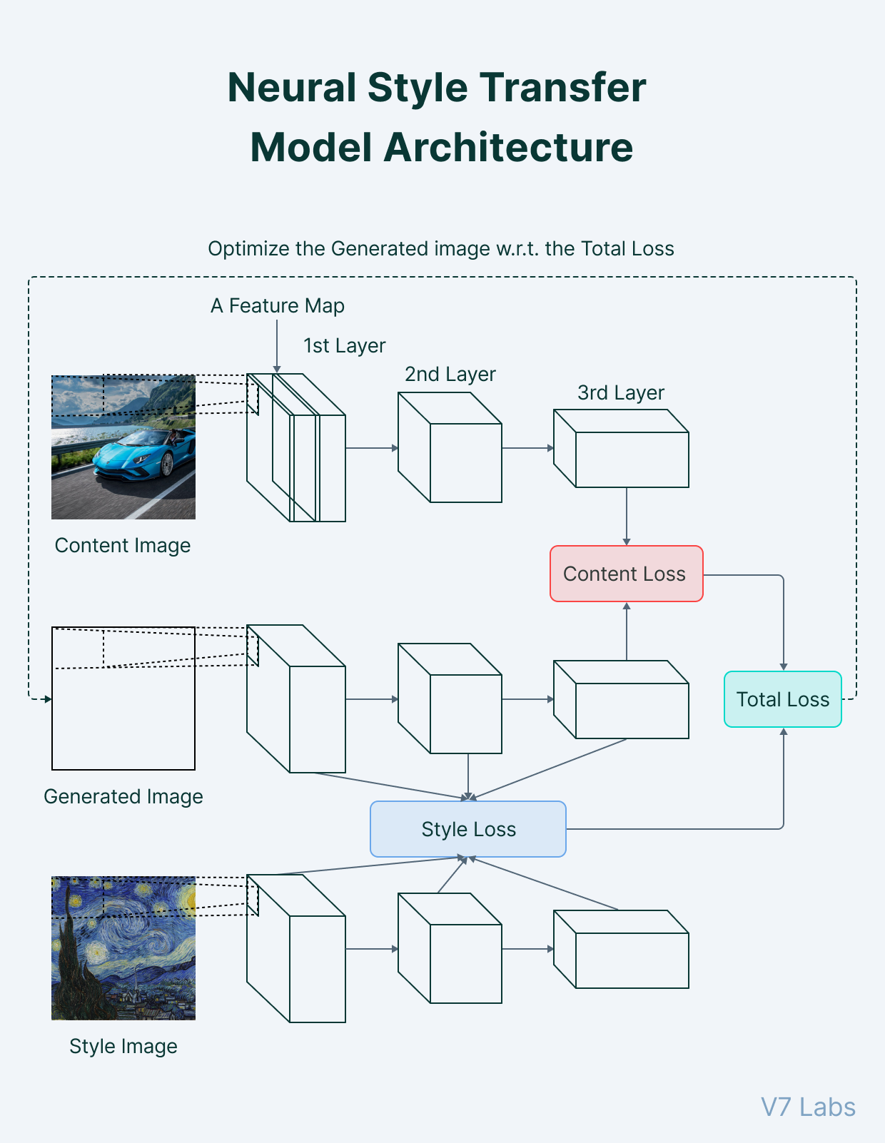
MODELLING
IMAGE COLLUSION

Slide 12
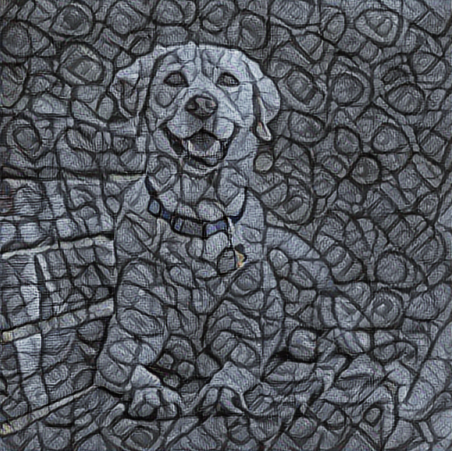
RESULTS
Generated Image (G): A new image that retains the content (objects and scene) from the content image (C) but incorporates the artistic style (texture, brushstrokes, colour palette) from the style image (S).
Output

Slide 13



